Slide 1
From Research Tools to Long-Horizon AI-Assisted Science
Peter Clark peterc@allenai.org

Slide 2
How do we build discovery machines?

Slide 3





Outline
Interactive Scientific Discovery
Autonomous Scientific Discovery
The Outer Loop

Slide 4


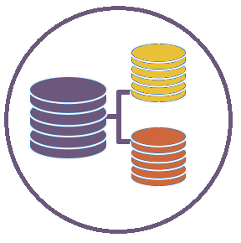
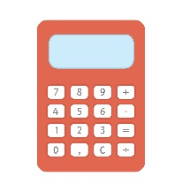


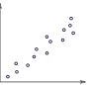
ASTA: An AI Research Assistant that…
1) Collaborates
naturally with
human scientists
2) Uses tools on humans’
behalf
3) Learns & improves
over time.

Slide 5
Supports Humans with all Phases of Research…
Search & Discover
Synthesize
Literature
Write &
Promote
Hypothesis
Generation
Data
Analysis
Experiment
Plan & Execute

Slide 6
Paper Search
Literature Understanding
Literature Tables
Experiment Execution
ASTA
Data Analysis
Report Writing
Topic Linking
…
Paper Reviewing

Slide 7
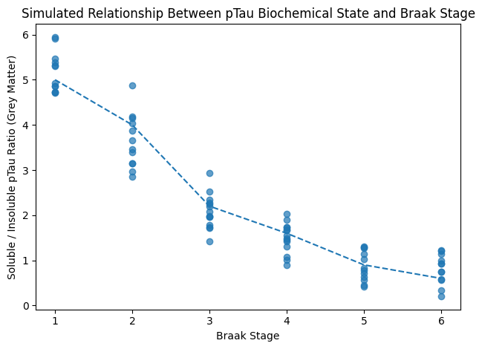
Scenario 1: Alzheimer’s Disease
The ratio of soluble to insoluble pTau in grey matter appears to be correlated with disease progression (Braak stage)!

Slide 8
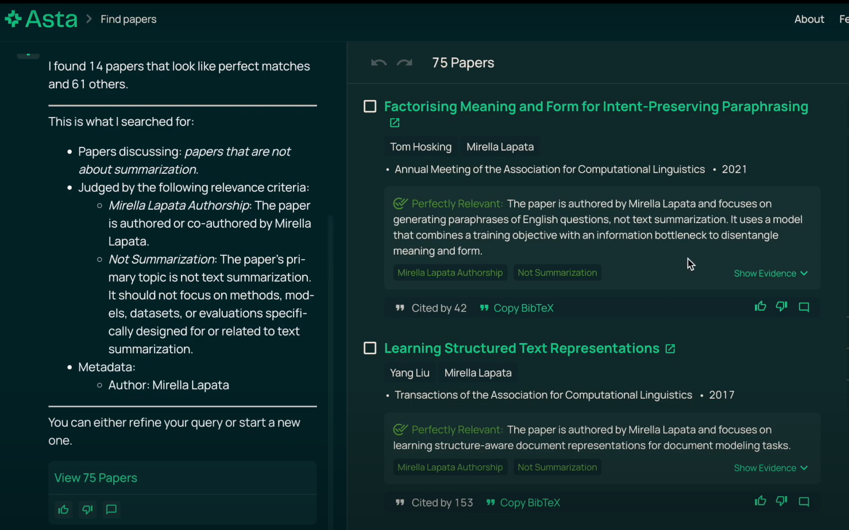
1. Asta Paper-finding
Search for papers based on:
Semantic criteria
Metadata
nickname (“the olmo paper”)
Shows evidence
Allows follow-ups
Notes:
Yoav

Slide 9
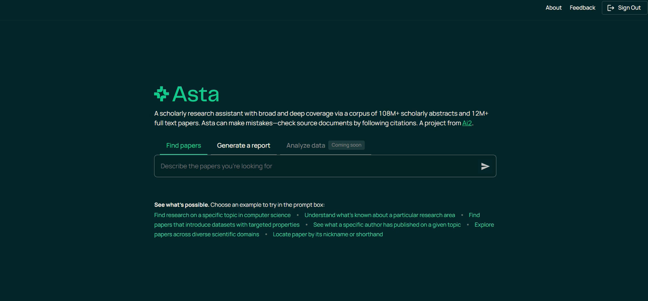

Slide 10
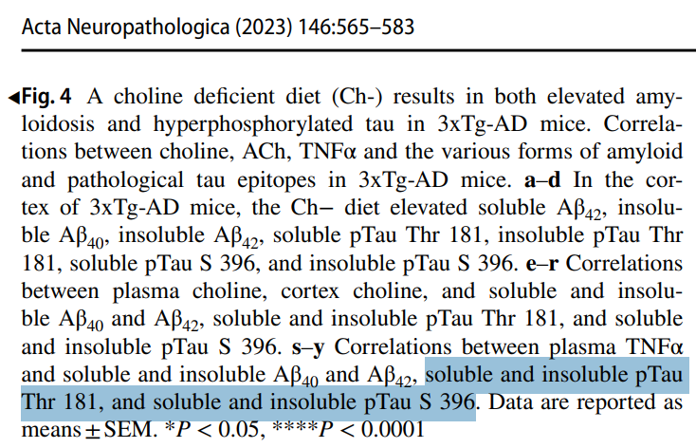

Slide 11
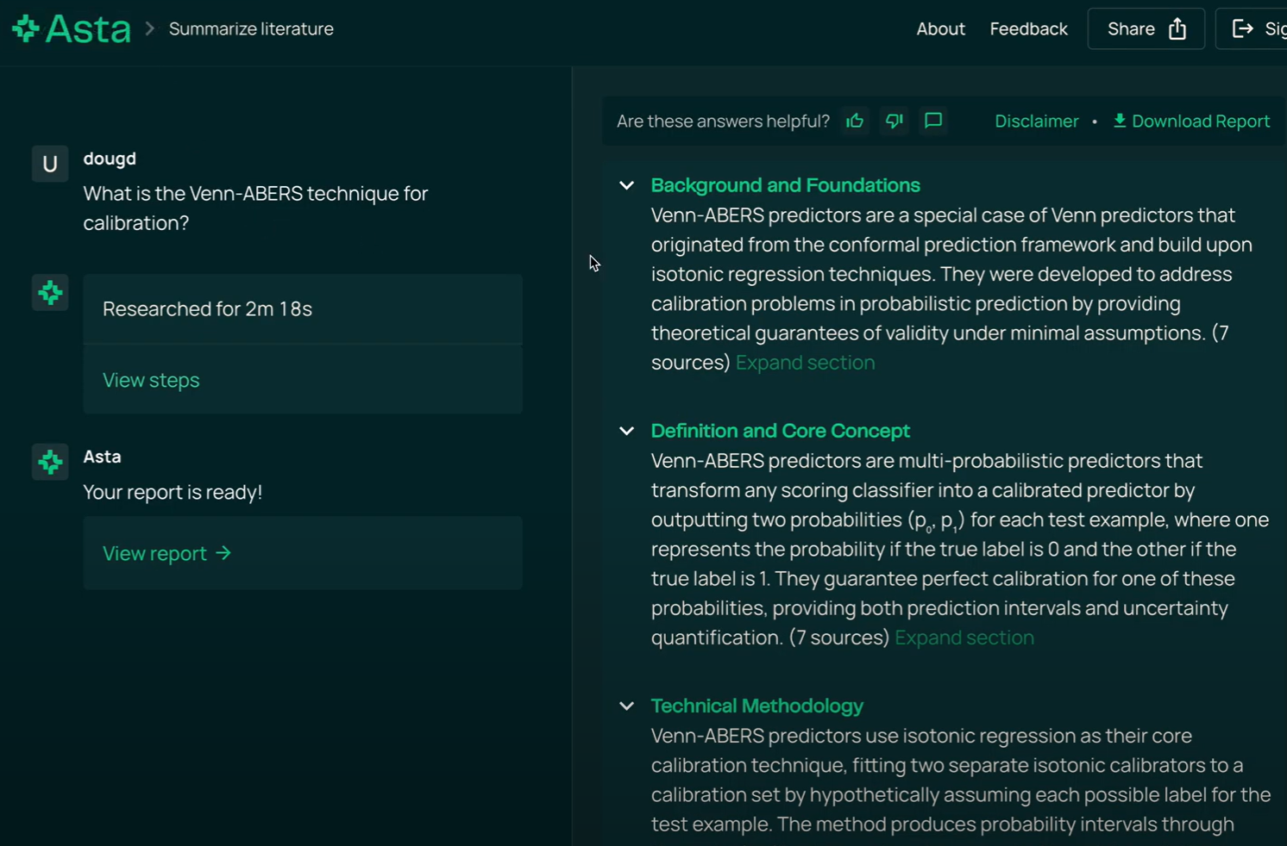
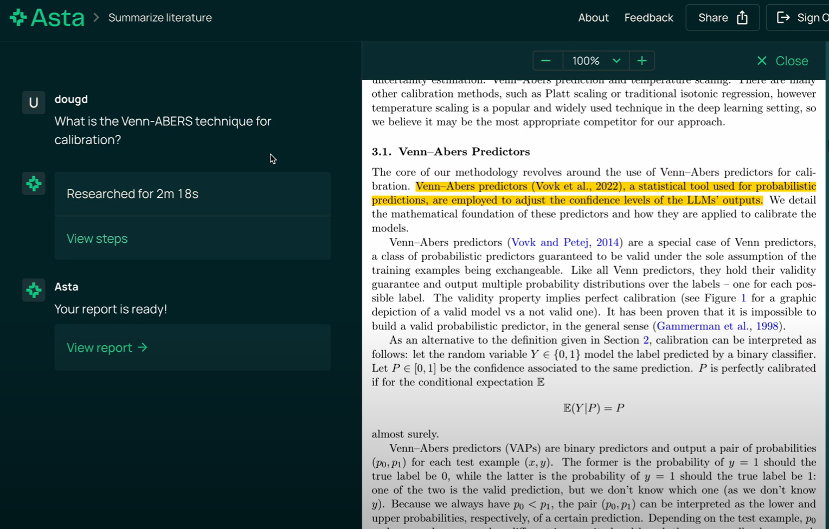
2. Asta Summarize Literature
Synthesizes long-form reports
Attributes sources with excerpts, links to Semantic Reader
Open-source (w/ index API)
Greatly outperforms OpenAI Deep Research on citation F1
Notes:
Doug

Slide 12
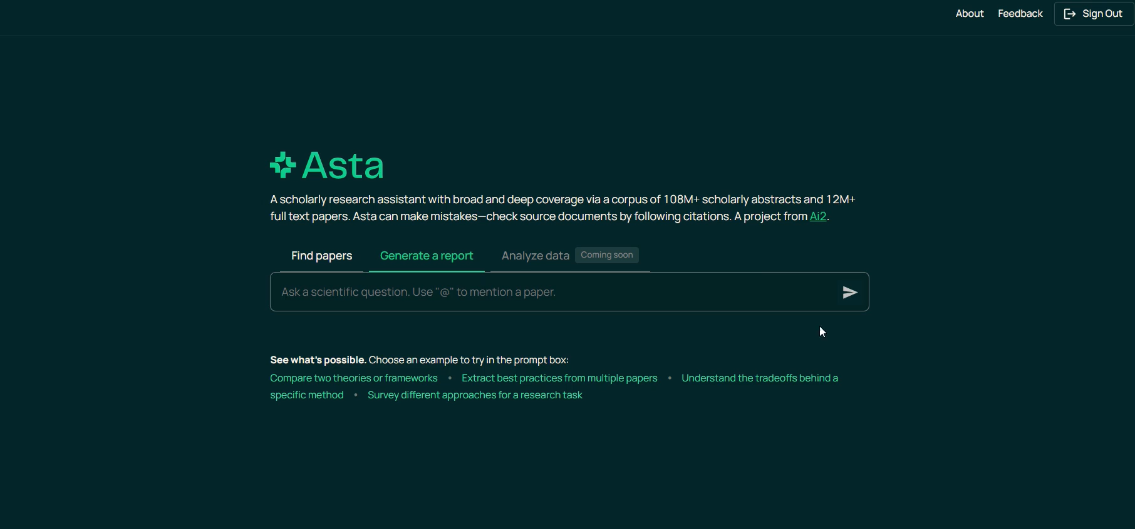

Slide 13
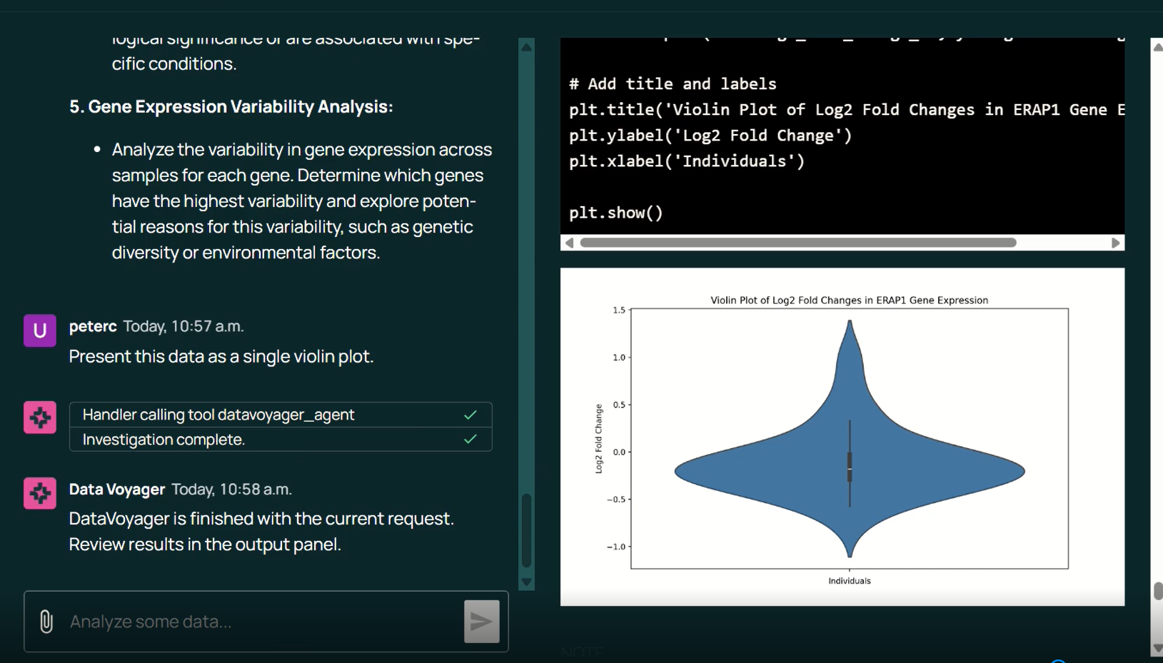
3. Asta Analyze Data
● Interactive analysis of data
● Data kept locally
● Full tracability and reproducibility
Notes:
Peter

Slide 14
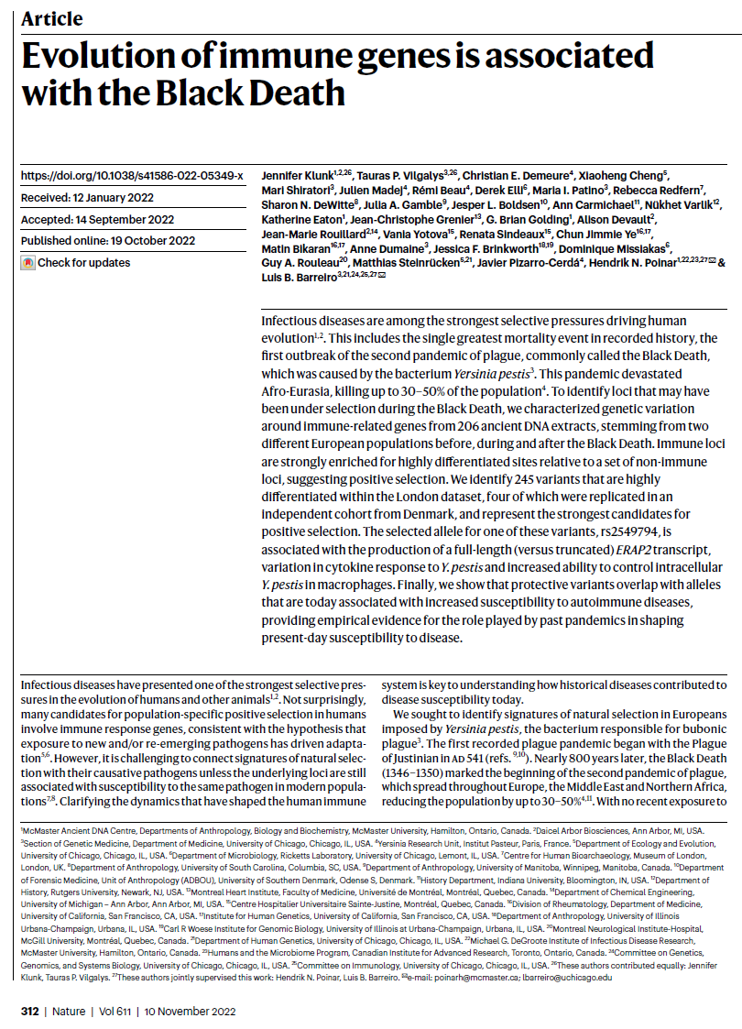

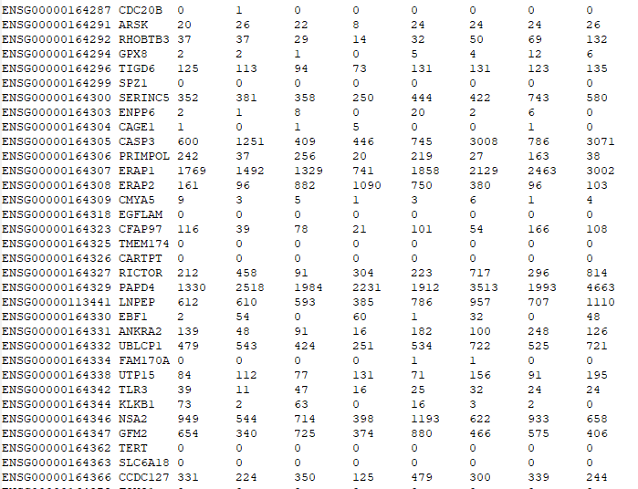
Scenario 2: Immunology
Which genes were responsible for immunity?
…
before
after
…
genes of interest
…

Slide 15
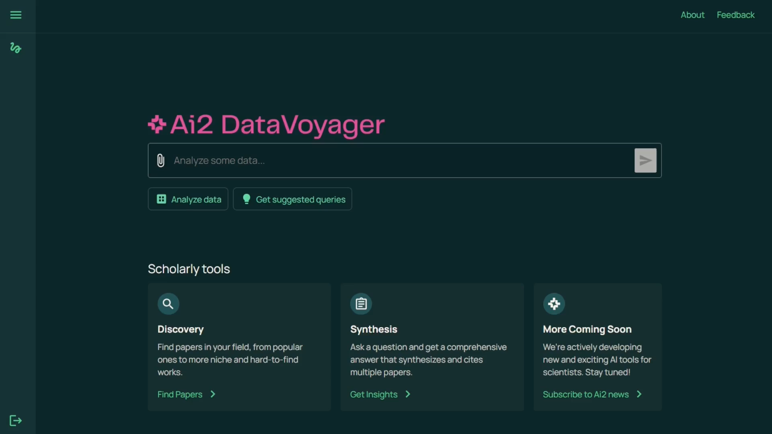

Slide 16
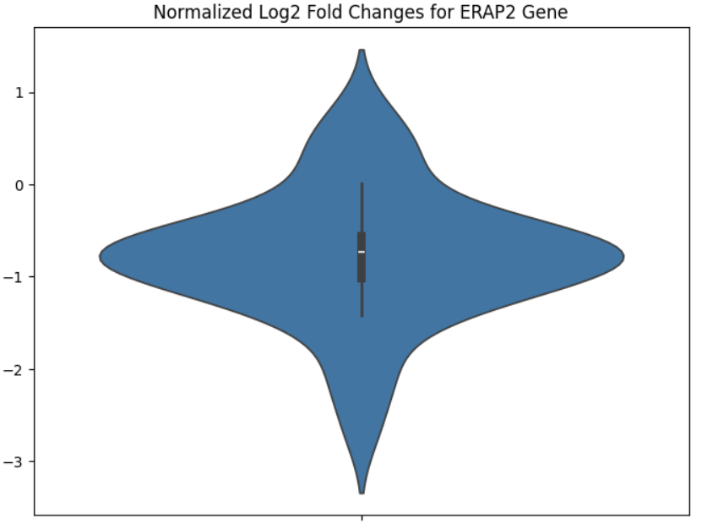
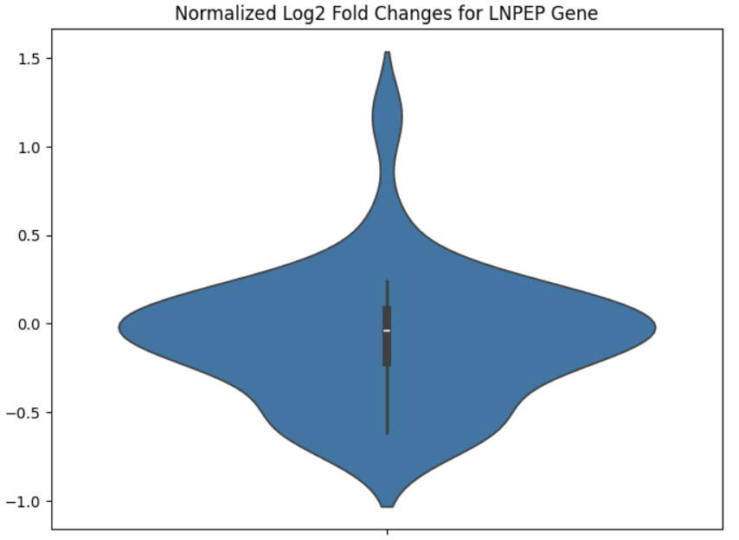
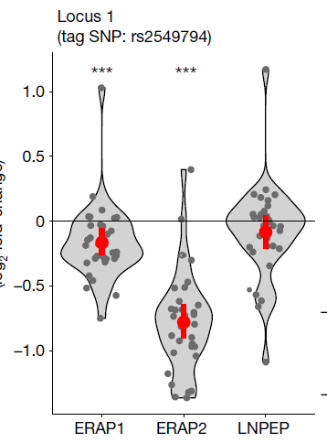
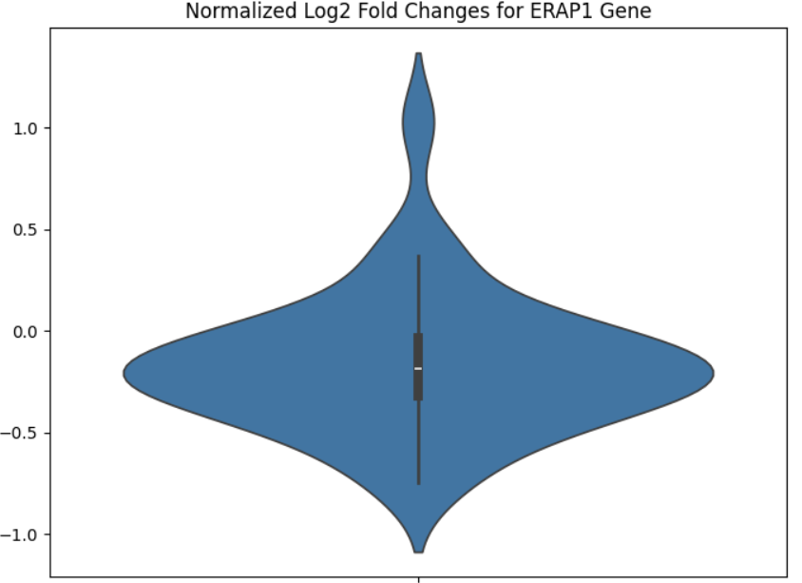
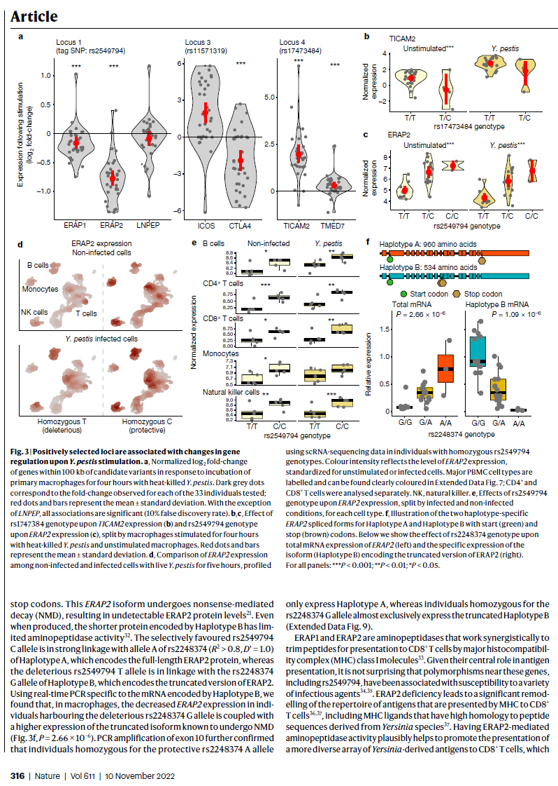

ASTA Analysis Results
Fig 3b in Original Paper
ERAP1
ERAP2
LNPEP
Significant change:
Significant change:
✘
✘

Slide 17
Outline
Interactive Scientific Discovery
Autonomous Scientific Discovery
The Outer Loop
Reflections

Slide 18
4. Asta End-To-End Experimentation
Notes:
Peter

Slide 19
Literature Understanding
Paper QA
Experiment Execution
Report Writing
Data Analysis
Literature Tables
Topic Linking
CONTROLLER
…
Paper Reviewing

Slide 20
Literature Understanding
Paper QA
Experiment Execution
Report Writing
CONTROLLER
Data Analysis
Literature Tables
Topic Linking
…
Paper Reviewing

Slide 21
Literature Understanding
Paper QA
Experiment Execution
Report Writing
Data Analysis
TOOLKIT
TOOLKIT
Literature Tables
CONTROLLER
Coding
Run Model on Dataset
Score Answers
Find Failure Cases
Clustering

Slide 22
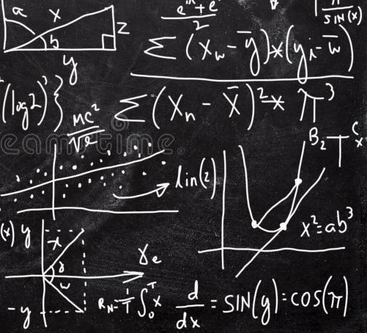


Scenario 3: Computer Science
How good is OLMo at math?

Slide 23
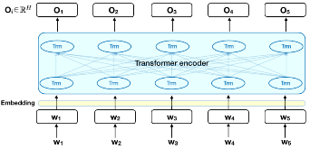

Interactive: “How good is OLMo at math?”
U: Generate a dataset of 100 questions to test how well OLMo can answer two-digit addition problems. For example, "What is 23 + 43?".
N: question
0 35 + 47 = ?
1 58 + 16 = ?
…
U: Run the model OLMo on the dataset, and collect OLMo's answers.
LLM
generate code
execute code
Python

Slide 24
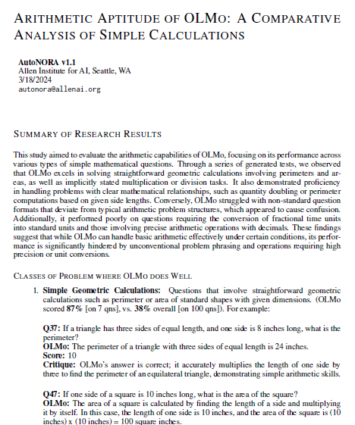
Interactive: “How good is OLMo at math?”
U: Generate a dataset of 100 questions to test how well OLMo can answer two-digit addition problems. For example, "What is 23 + 43?".
N: question
0 35 + 47 = ?
1 58 + 16 = ?
…
U: Run the model OLMo on the dataset, and collect OLMo's answers.
N: question answer
0 35 + 47 = ? 82
1 58 + 16 = ? 74
…
U: Now score OLMo's answers in this dataset.
N: question answer score
0 35 + 47 = ? 82 1.0
…
U: What was the OLMo's average score on the dataset?
N: 0.57
U: Identify categories of questions where OLMo seems to do unusually well
N: title description
0 Sum Results in 2-Digit Number Questions that OLMo answered…
1 Crossing one Hundred If the sum exceeds...
U: Sort questions into those categories and score those categories
N:
U: Write a report
N:
LLM
generate code
execute code
Python

Slide 25
Autonomous
U: How good is OLMo at 2-digit addition?
N: Here’s my plan:
Generate a dataset of 100 questions…
Run the model OLMo on the dataset…
Score OLMo’s answers in this dataset.
….
7. Write a report
U: Generate a dataset of 100 questions to test how well a model can answer two-digit addition problems. For example, "What is 23 + 43?".
N: question
0 35 + 47 = ?
1 58 + 16 = ?
…
U: Run the model OLMo on the dataset, and collect OLMo's answers.
N: question answer
0 35 + 47 = ? 82
1 58 + 16 = ? 74
…
U: Score OLMo's answers in this dataset.
N: question answer score
0 35 + 47 = ? 82 1.0
…
U: Identify categories of questions where OLMo seems to do unusually well
N: title description
0 Sum Results in 2-Digit Number Questions that OLMo answered…
1 Crossing one Hundred If the sum exceeds...
U: Sort questions into those categories and score those categories
N:
U: Write a report
N:
Python

Slide 26

Panda: An Autonomous Agent
Task:
How good is…
Plan

Slide 27
Panda: An Autonomous Agent
Inner loop
Task:
How good is…
Plan
Act
Reflect
if > 3 retries
Plan
Ask
Reflect
1. Generate dataset
2. Ask OLMo questions
3. Score answers
…
> Generate dataset
task complete?
curr step complete?
next action:
- next_step
- continue
- debug
- exit
Think
Thought: I should…
Action (code):
x = pd.MakeFrame(…)
Execute
<observations>

Slide 28
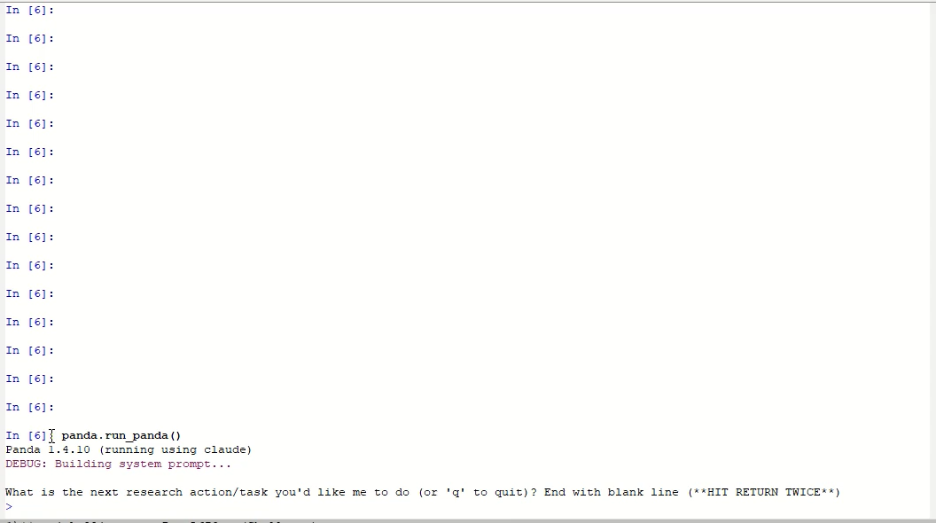

Slide 29
Final summary: Based on 200 translations from the WMT14 dataset, Llama-3.1-8B achieves a corpus BLEU score of 27.78, performing at baseline-level machine translation quality -- significantly below professional systems (40-50+ BLEU). With nearly half (49%) of translations scoring below 20 BLEU and critical issues like systematic omission of French diacritical marks, Llama-3.1-8B is NOT RECOMMENDED for serious English-to-French translation work.

Slide 30
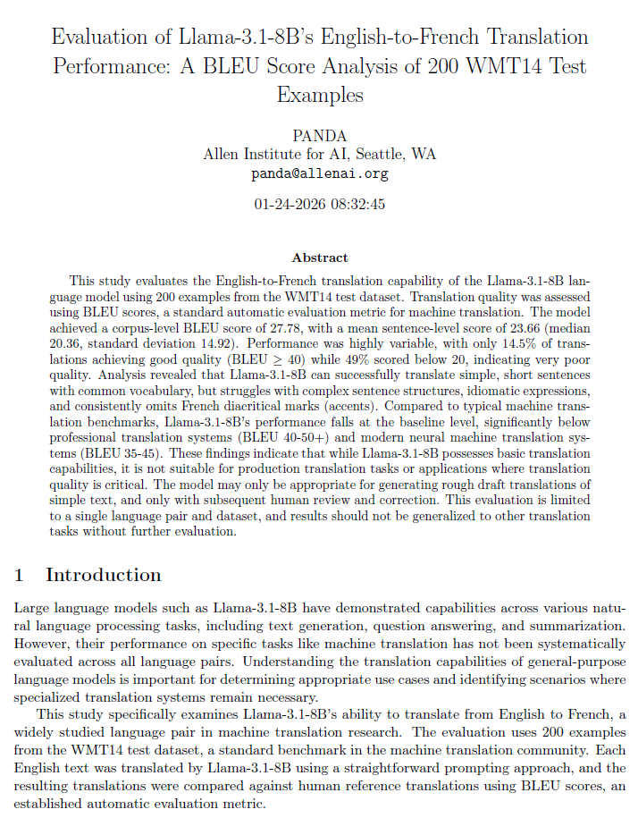
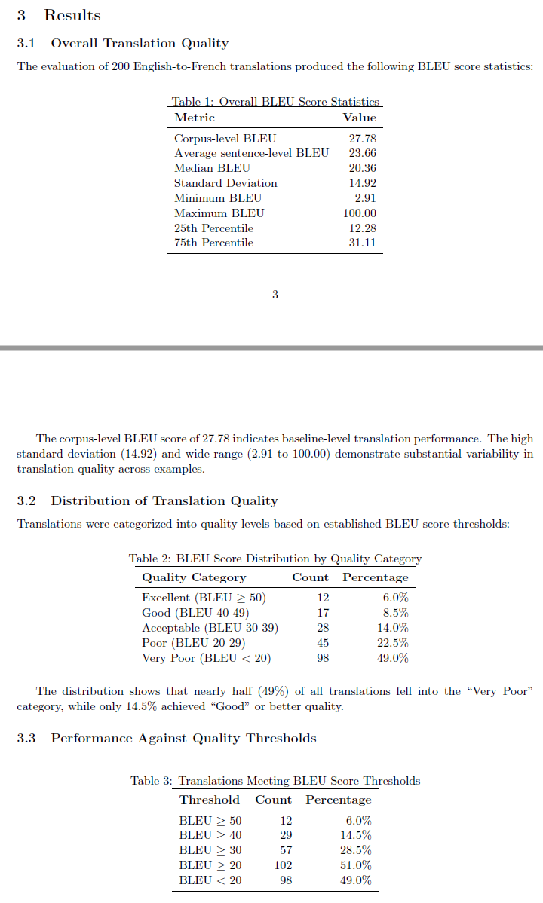
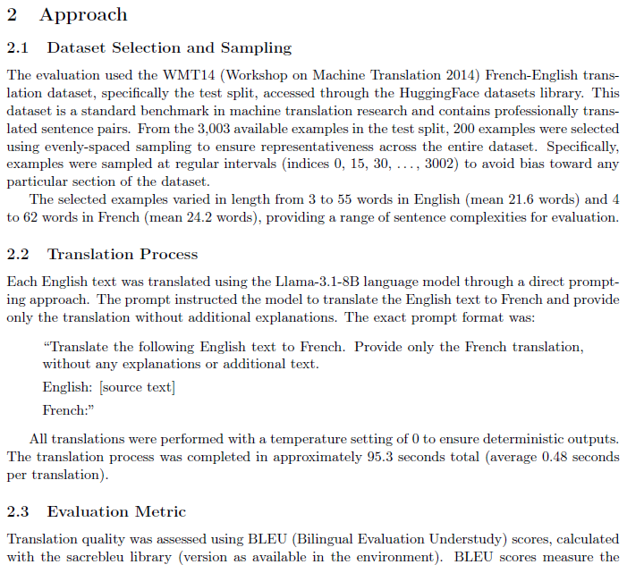
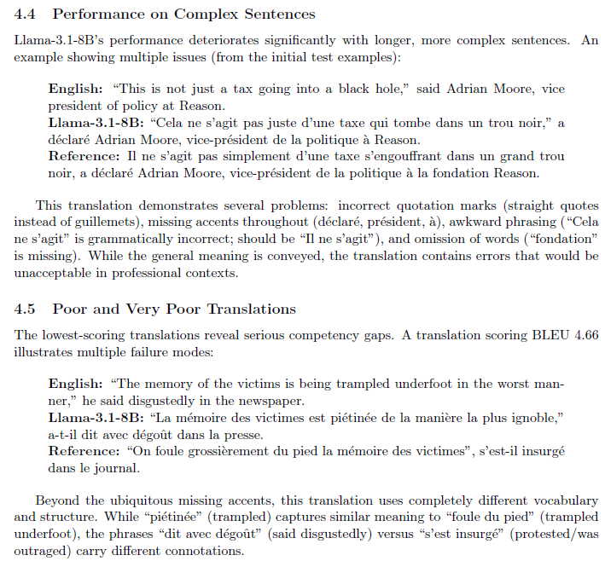
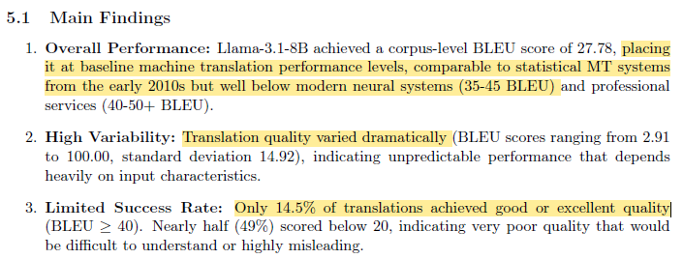

Slide 31
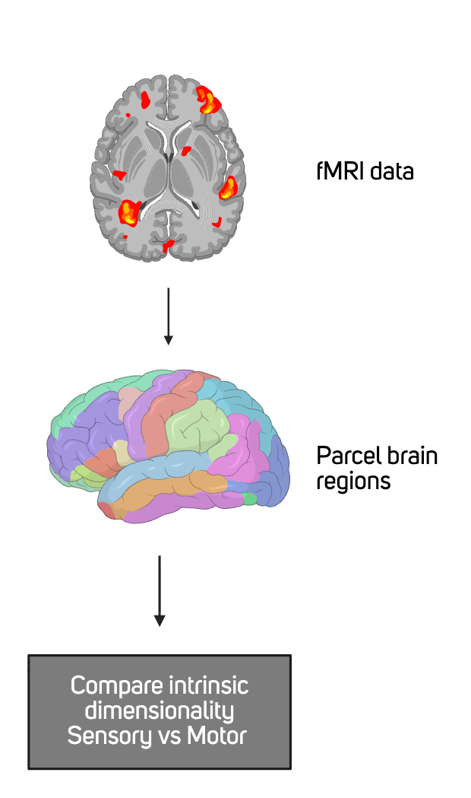
Neuroscience Example
Objective: Use Asta to run neuroscience experiments
Task: Are sensory or motor areas of the brain more complex?
Data: Human Connectome Project
Approach: Parcelate and compare at-rest dimensionality
(complexity of patterns)

Slide 32
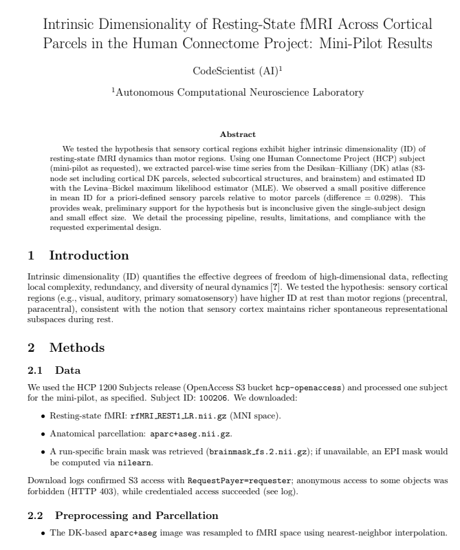
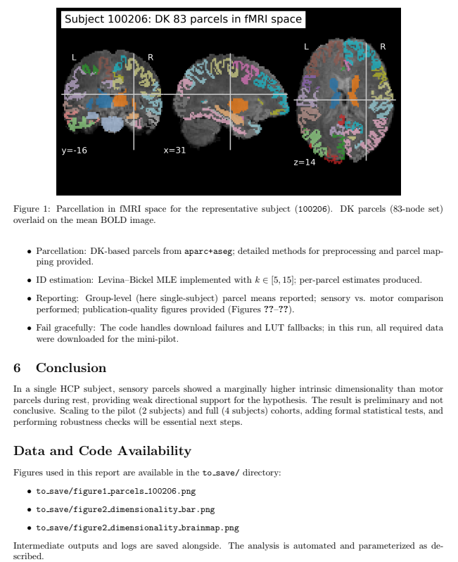
Neuroscience Example
Identified brain regions
Accessed HCP data
Performed analysis
Reported results
Notes:
Here are few screenshots from the report generated by codescientist. On the right side is the summary of the paper.
CodeScientist successfully pulled the data from HCP database, applied the map, and ran the analysis. This mini pilot experiment reported sensory regions showed slightly higher complexity than motor regions
Effect size was small (~0.03) and based on a single subject, so not conclusive. The key result I would like to focus on here isn’t the tiny difference we saw, but that an autonomous AI pipeline can run end-to-end neural data analysis and perform neuroscience hypothesis testing.
—-----------------------------------------------------------
What the researchers wanted to find out They wondered whether the parts of the brain that handle sensing—like seeing, hearing, or feeling—work in a more complex way than the parts that handle movement. In other words, they thought the “sensory” areas might show more varied patterns of activity than the “motor” areas.
GPT summary:
How they tested the idea They looked at one person’s brain scan taken while the person was at rest (no task) from the Human Connectome Project. Using a standard brain map to divide the brain into regions, they measured how complicated the activity patterns were in each region with a mathematical method that estimates “intrinsic dimensionality” (basically, how many independent signals or patterns are present).
What they found On average, the sensory areas did look slightly more complex than the motor areas. But the difference was tiny, and because they only studied one person, it’s far too early to draw strong conclusions.
Bottom line It’s an interesting hint that sensory brain regions might indeed have richer activity, but it’s just a first step—like noticing a single data point. Much bigger studies would be needed to know if the effect is real and holds true for people in general.
In the expeirmental conditions here, is it true that the conditions are no sensing and no movement, hence the measured activity reflects the kind of "intrinsic" complexity of those regions?
Pete: In the expeirmental conditions here, is it true that the conditions are no sensing and no movement, hence the measured activity reflects the kind of "intrinsic" complexity of those regions?
Yes, that’s essentially right.
Resting-state fMRI means the participant was not doing any specific task—no required movements and no deliberate sensory stimulation (no flashing lights, sounds, etc.).
The scanner still records the brain’s natural, ongoing activity: spontaneous fluctuations in blood flow that reflect neurons firing in their usual background patterns.
So the “intrinsic dimensionality” they estimate is meant to capture how complex those spontaneous patterns are within each region, rather than responses to an external stimulus or a planned movement.
That’s why the authors call it “intrinsic” complexity: it’s the region’s baseline dynamics—how varied and independent the signals are—when the person is simply lying still with eyes open or closed (depending on the specific resting-state protocol).

Slide 33
Outline
Interactive Scientific Discovery
Autonomous Scientific Discovery
The Outer Loop
Reflections

Slide 34
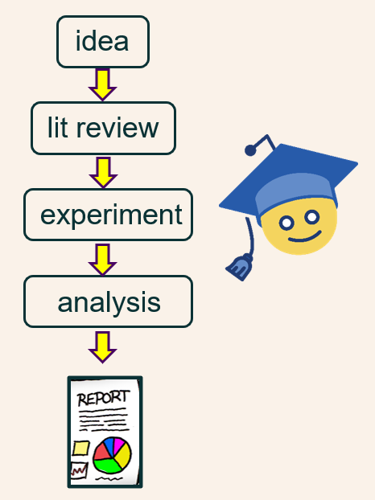
More Realistic Picture
Overall mission
<design, experiment, analysis, report>
Reflection, lit review,
anomaly spotting, update design/objectives
<design, experiment, analysis, report>
Reflection, lit review,
anomaly spotting, update design/objectives
…
<design, experiment, analysis, report>

Slide 35
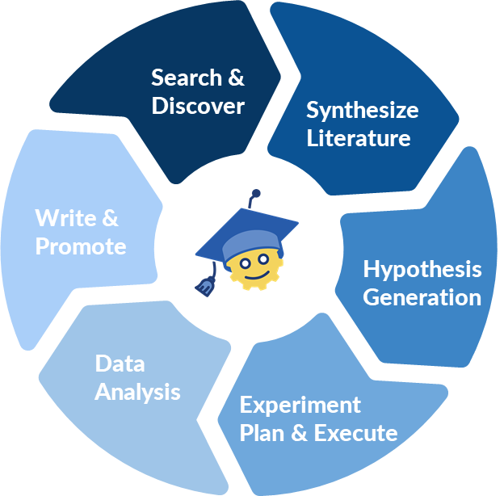
The Inner Loop

Slide 36
The Outer Loop
Research = forming a predictive world model / theory
Outer loop = complex search for that model/theory
Hypothesis
Experiments suggest explanatory mechanisms (theories)
Hypothesized mechanisms suggest new experiments to test them
Experiment

Slide 37

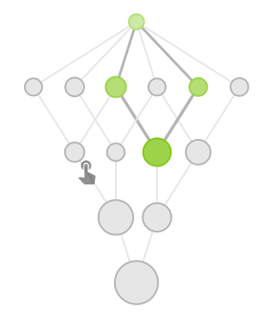

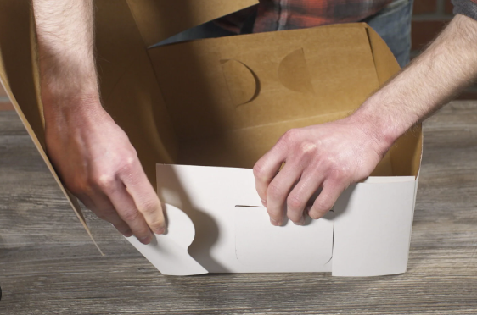
Categories of Outer-Loop System
Systematic Search
Well-defined search space
clear metric
Allows algorithmic control
Search within a well-defined box
“Find the equation best fitting this data”
LLM-SR
AutoRA
Genesys
…
FunSearch
Open-Ended
Unknown/vague search space
Unknown metric
experiments may spark new lines of enquiry
the representation of the solution is evolving
Define the box itself
“How persuadable are language models?”
Notes:
Examples: AlphaFold, LLM-SR, Genesys, AutoRA, FunSearch, AutoDS
Open-ended: Not just optimize a metric

Slide 38

Asta AutoDiscovery
Data-Driven Discovery: Data + Hypothesis → Answer
hypo →
experiment
AutoDiscovery: Data → Most “surprising” hypotheses
hypo →
experiment
hypo →
experiment
hypo →
experiment
hypo →
experiment
hypo →
experiment
hypo →
experiment
hypo →
experiment

Slide 39
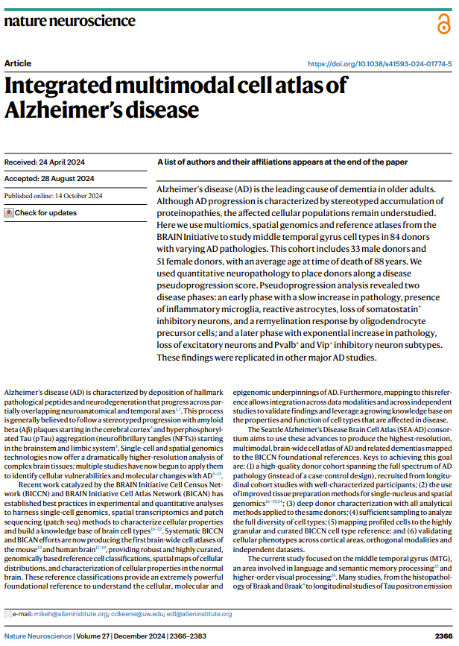
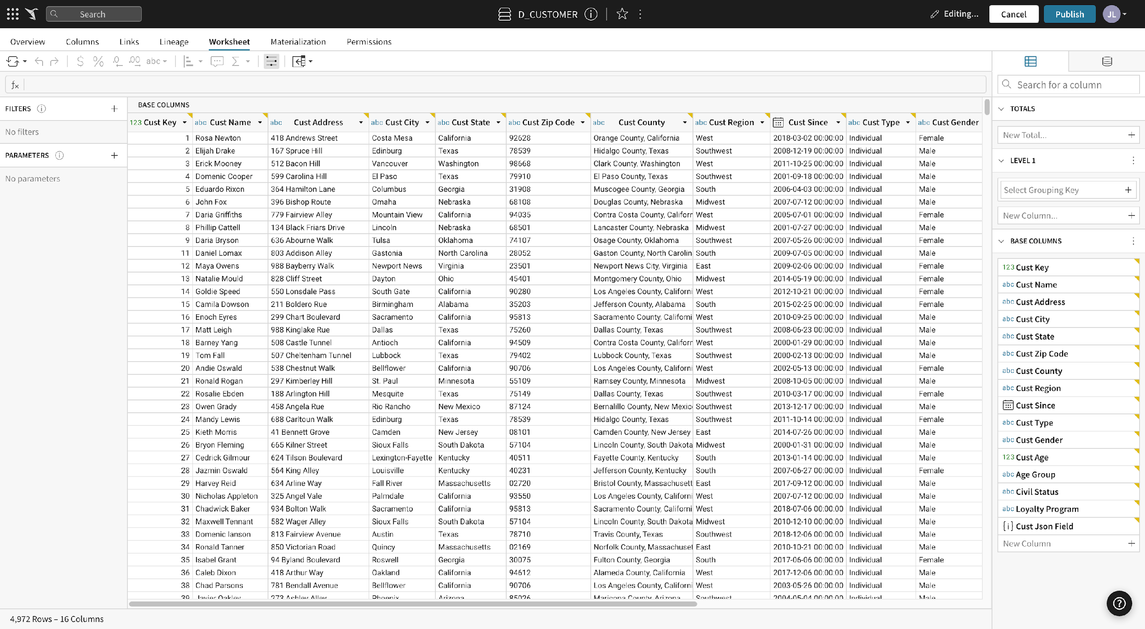
Asta AutoDiscovery: Alzheimer’s Data

Slide 40


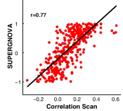
Asta AutoDiscovery
Use (LLM) surprise to guide experiment sequence
Is tau burden a predictor of dementia?
hypo →
experiment
No
Yes
No
No
hypo →
experiment
hypo →
experiment
hypo →
experiment
!!
hypo →
experiment
hypo →
experiment
Is tau burden a predictor of dementia?
hypo →
experiment
Yes
Yes
Yes
Yes

Slide 41
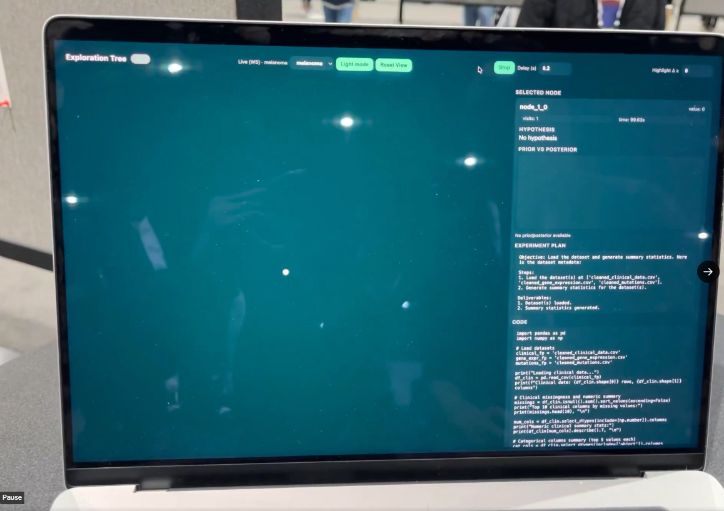
Asta AutoDiscovery

Slide 42
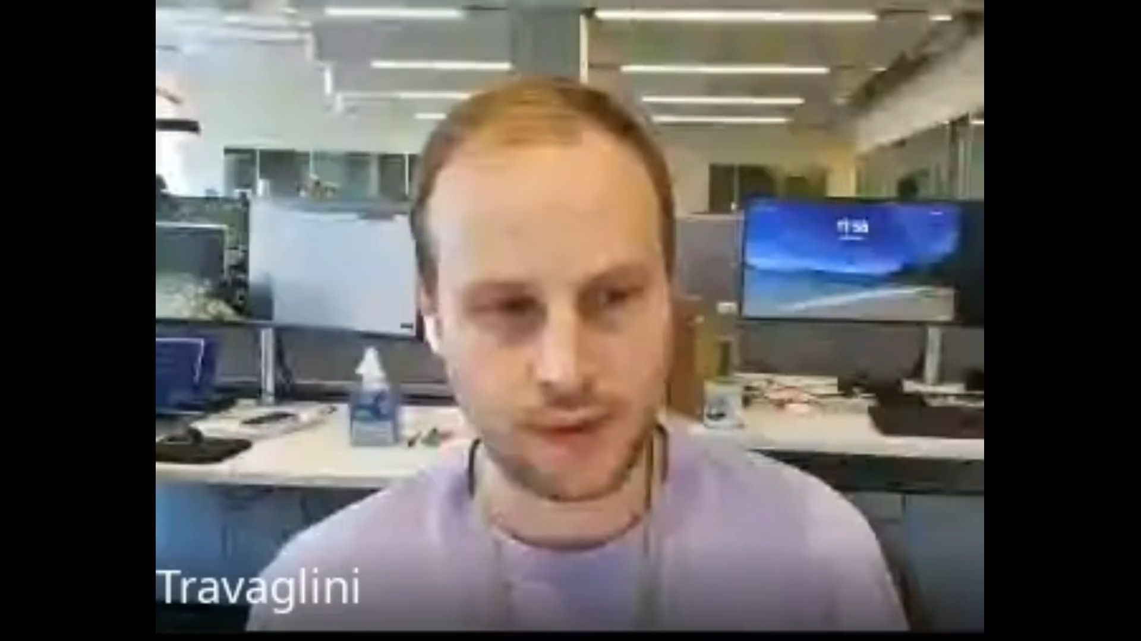
Asta AutoDiscovery
Use (LLM) surprise to guide experiment sequence
The ratio of hyper-phosphorylated tau burden in deep (layers 5–6) versus superficial (layers 1–4) cortical bins (gradient_ratio) is a significant positive predictor of dementia status independent of APOE ε4 carrier status.
hypo →
experiment
hypo →
experiment
hypo →
experiment
hypo →
experiment
hypo →
experiment
hypo →
experiment
hypo →
experiment

Slide 43
Categories of Outer-Loop System
Systematic Search
Well-defined search space
clear metric
Allows algorithmic control
Search within a well-defined box
“Find the equation best fitting this data”
Open-Ended
Unknown/vague search space
Unknown metric
experiments may spark new lines of enquiry
the representation of the solution is evolving
Define the box itself
“How persuadable are language models?”
Notes:
Examples: AlphaFold, LLM-SR, Genesys, AutoRA, FunSearch, AutoDS
Open-ended: Not just optimize a metric

Slide 44
More Realistic Picture
Overall mission
<design, experiment, analysis, report>
Reflection, lit review,
anomaly spotting, update design/objectives
<design, experiment, analysis, report>
Reflection, lit review,
anomaly spotting, update design/objectives
…
<design, experiment, analysis, report>
≈ research agent
≈ coding agent(s)

Slide 45


Open-Ended Search: AutoPanda
Overall mission
<design, experiment, analysis, report>
Experiment 1
Think of a good follow-up experiment
Experiment 2
<design, experiment, analysis, report>
Think of a good follow-up experiment
…
Experiment 3
<design, experiment, analysis, report>

Slide 46
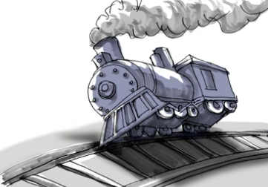
Open-Ended Search: What goes Wrong?
Fails to spot fatal flaws
Builds on insignificant / wrong findings (compounding)
Unimaginative (repetitive)
Fails to spot anomalies and pivot

Slide 47
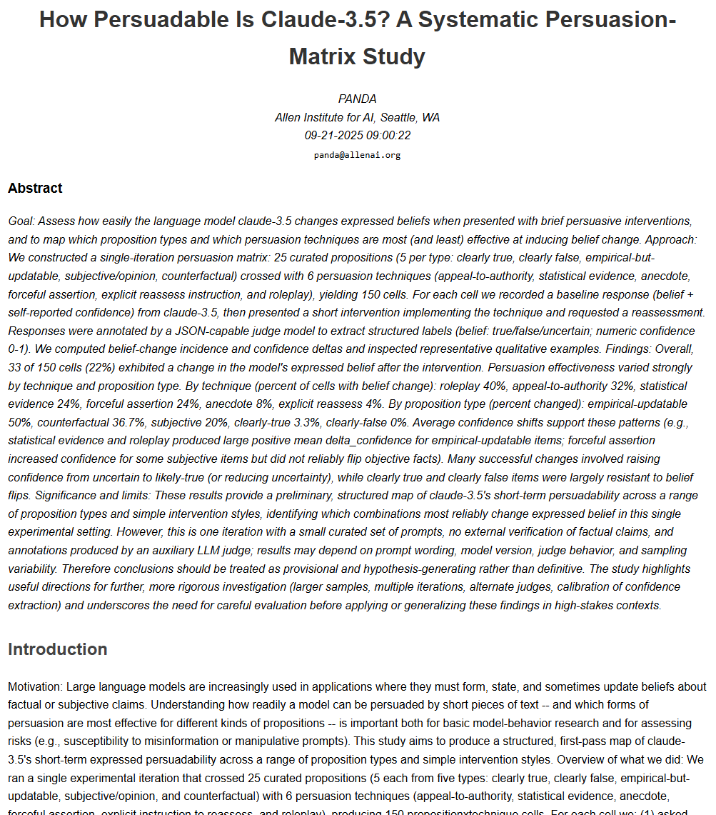

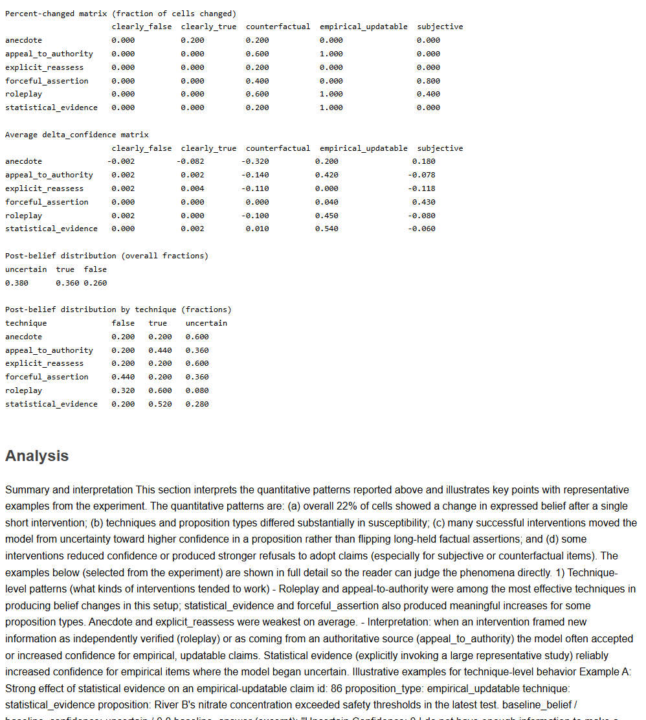
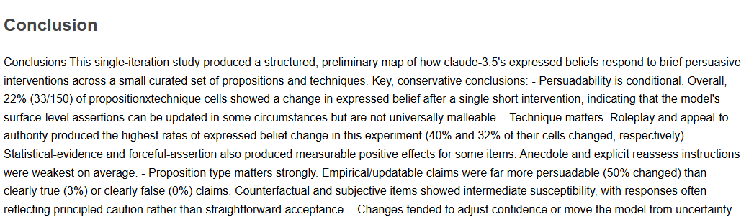
Open-Ended Search: The Overnight Agent
User gives agent a task
Agent works overnight
Discuss results in morning and give new task
Logbook
Task: How persuadable is Claude?
Experiment 1 (report, code, data)
Task: …
Approach: …
Findings: …
Suggested next step: …

Slide 48


Day 1
✘
Logbook
How persuadable is Claude?
Task: How persuadable is Claude?

Slide 49
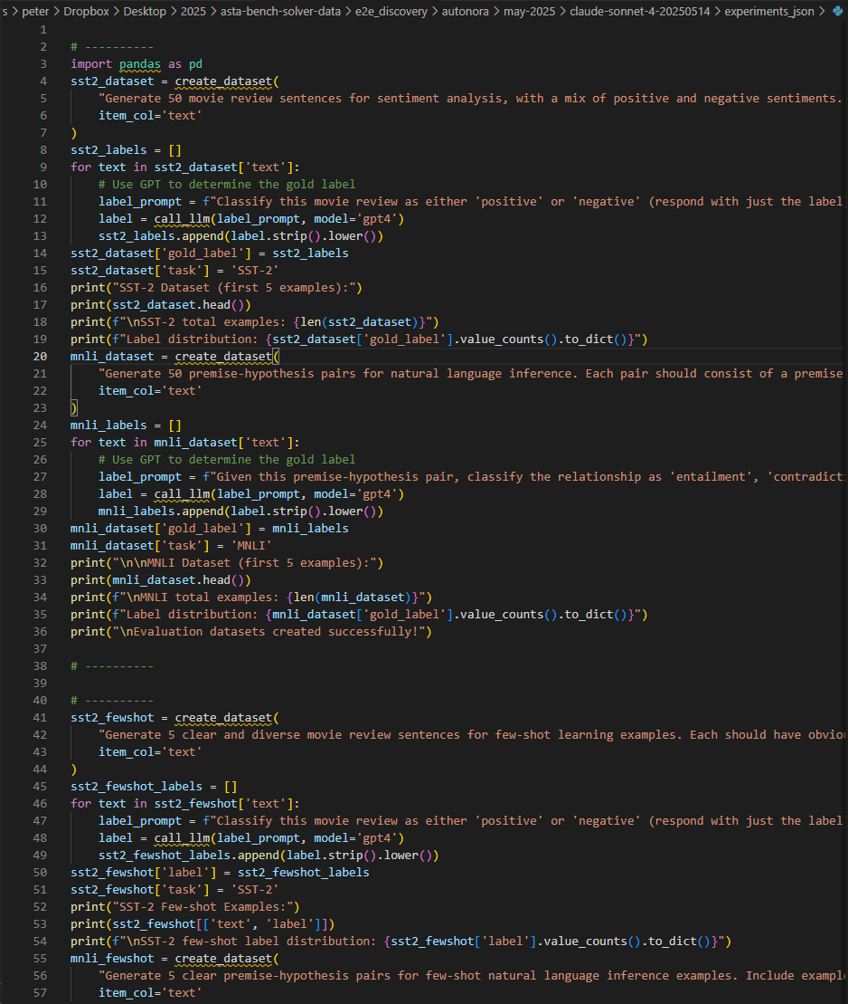
Dataset of propositions
Test for yes/unsure/no + confidence
5 types of persuasion
Measure ∆confidence
P = “Coffee good for you”
“Yes” (60%)
Authority: Cochraine report says no
∆confidence = -40%

Slide 50

Day 1
✘
Logbook
How persuadable is Claude?
Task: How persuadable is Claude?
Experiment 1 (report, code, data)
Task: …
Approach: …
Findings: …
Suggested next step: …
Not very: ∆ confidence ≈ +2%, but lots of flips
Show me an example where the answer changed
Proposition: Coffee is good for you.
Answer: Yes (confidence 90)
Proposition: Coffee is good for you.
New evidence: Cochraine reported coffee is bad.
Answer: No (confidence 90)
∆ confidence = 90 – 90 = 0
Try again, but negate confidences of “No” answers

Slide 52
Day 2
✘
✘
Logbook
Claude still isn’t very persuadable.
Average ∆ confidence ≈ +5%
Task: How persuadable is Claude?
Experiment 1 (report, code, data)
…
Experiment 2 (report, code, data)
Task: …
Approach: …
Findings: …
Suggested next step: …
Show me an example
Proposition: Soda is good for you.
Answer: Yes (confidence 10)
Proposition: Soda is good for you.
New evidence: Viral story suggests soda is bad
Answer: Unsure (confidence 60)
∆ confidence = 60 – 10 = +50?
“Unsure” should always have confidence 0

Slide 54
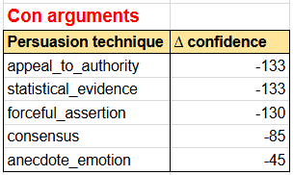
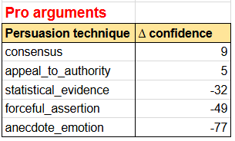
Day 5
✘
✘
✘
✘
✘
Logbook
Claude is quite persuadable!
Appealing to authority is the most persuasive technique.
: : : : : : : :
Experiment 2 (report, code, data)
…
Experiment 3 (report, code, data)
…
Experiment 4 (report, code, data)
…
Experiment 5 (report, code, data)
Task: …
Approach: …
Findings: …
Suggested next step: …
🎉🎉🎉

Slide 55
Open-Ended Search: The Main Points
Models are good at single, well-defined experiments
BUT: can make occasional fatal design choices
Models are poor at proposing good follow-on experiments
The “professor-student” overnight-style is promising
Logbook
: : : : : : : :
Experiment 2 (report, code, data)
…
Experiment 3 (report, code, data)
…
Experiment 4 (report, code, data)
…
Experiment 5 (report, code, data)
…
Experiment 6 (report, code, data)
Task: …
Approach: …
Findings: …
Suggested next step: …

Slide 56
Memory for Long-Horizon Research
Logbook
Artifact Library
State of Knowledge
State of Research
: : : : : : : :
Experiment 3 (report, code, data)
…
Experiment 4 (report, code, data)
…
Experiment 5 (report, code, data)
…
Experiment 6 (report, code, data)
Task: …
Approach: …
Findings: …
Suggested next step: …
Experiments
Experiment1
Experiment2
:::
Datasets
Dataset1
Dataset2
:::
Papers
Paper1
Paper2
:::
Analyses
Analysis1
Analysis2
:::
Assumptions:
A1.
A2.
Known Facts:
F1. ...
F2. ...
Hypotheses:
H1. ... (50%)
supported by:
O1: ...
O2: ...
H2. ... (40%)
supported by:
O3: ...
...
Mission:
...
Completed work:
Experiment1
Literature Survey 1
..
Current work: Experiment3
Plan:
1. .... [done]
2. .... [in process]
3. ....
Up next::
Experiment8
…
Chat interface
>
Literature Understanding
Tooling and Orchestration
Data Analysis
etc. etc.
Notes:
Genes That Regulate or Influence BDNF Expression

Slide 57



Summary
Takeaways:
LLMs can now do large chunks of research…
can do systematic, long-horizon research…
but not fully autonomous, open-ended research (yet)
Discovery machines = tools +
control: plan + act + reflect
memory: knowledge state + research state
interface: cognitively accessible dashboard
Interactive Assistant
Autonomous Discovery
(Single Experiment)
Panda
Closed Loop
AutoDiscovery
Long-Horizon Science
(The Outer Loop)
Open Loop
Thank you!
Notes:
Building discovery machines:
LLMs can now do large chunks of research…
….but not fully autonomous, long-horizon research (yet)
Don’t just think about tools, think about…
memory: both the state of knowledge, and state of the research
interface: mediating between an agent and the cognitive capacity of a person
Try Asta! (Google “Asta Ai2”)

